Slide 1
Lab 6: Imaging tools (Roboflow)
3099704 AI for Digital Health (2025/2)

Slide 2
Outline
Objective
Material
- Colab
- Roboflow: Intro & Limitation
Other Data Labeling Tools
Lab 6.1: Object detection dataset (Polyp Detection)
- Roboflow -> Ultralytics HUB -> Colab
Lab 6.2: Segmentation dataset (Polyp Segmentation)
- Roboflow -> Colab (MONAI)

Slide 3


Objective
Use the Roboflow to create a dataset.
Use the created dataset to train the model (YOLO, UNet).
3

Slide 4
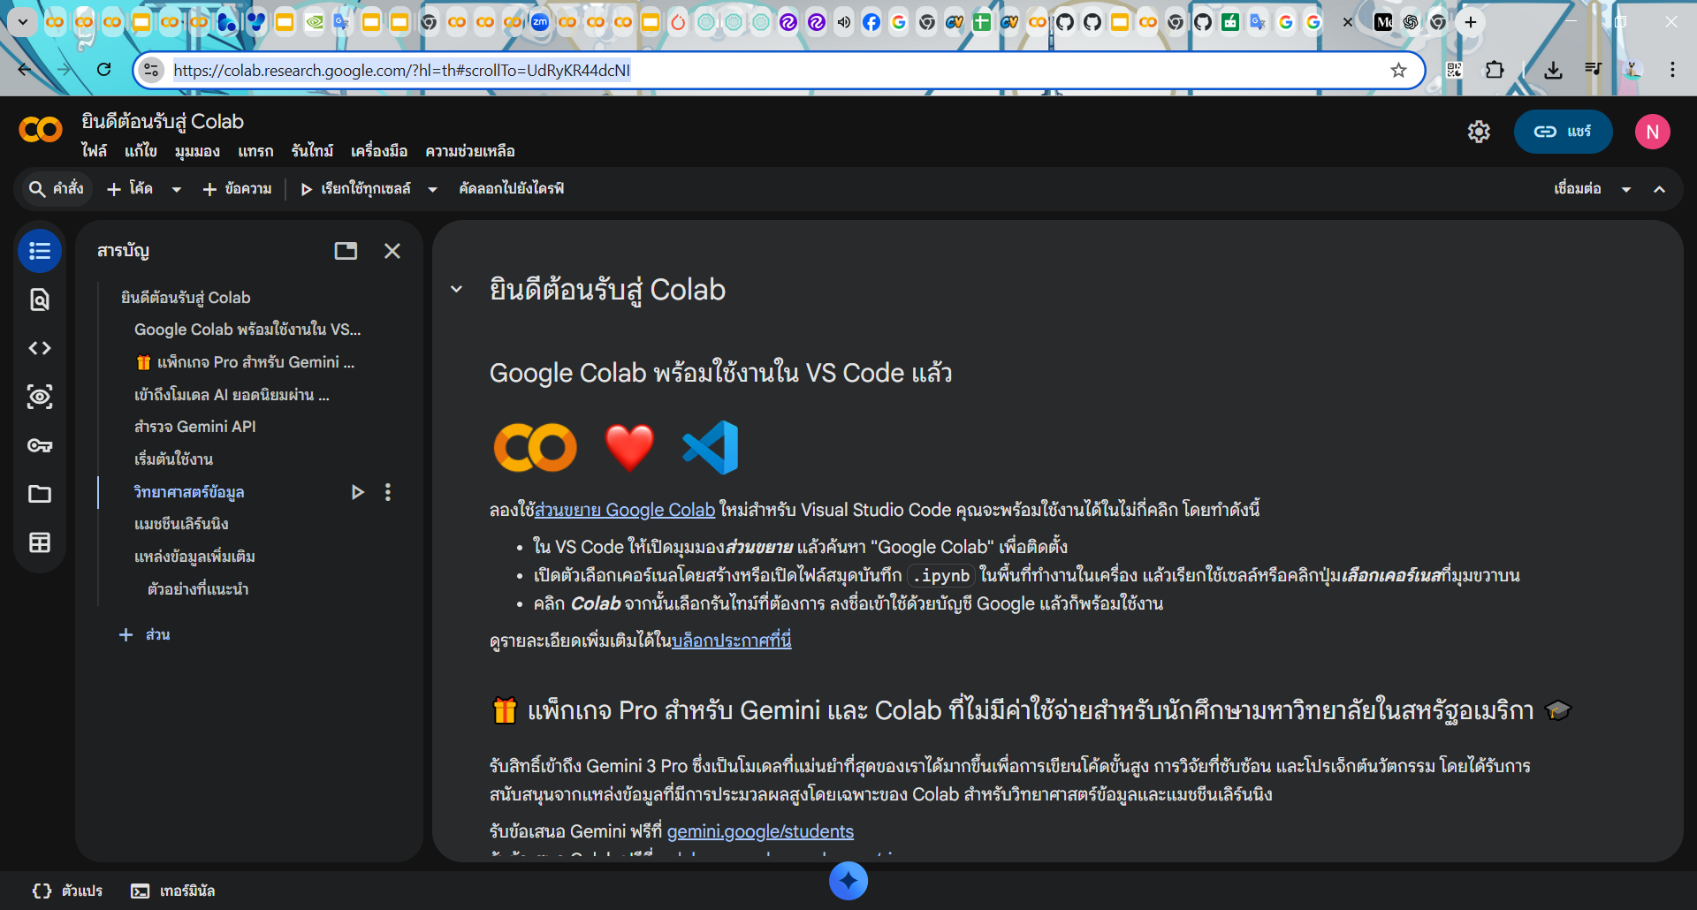
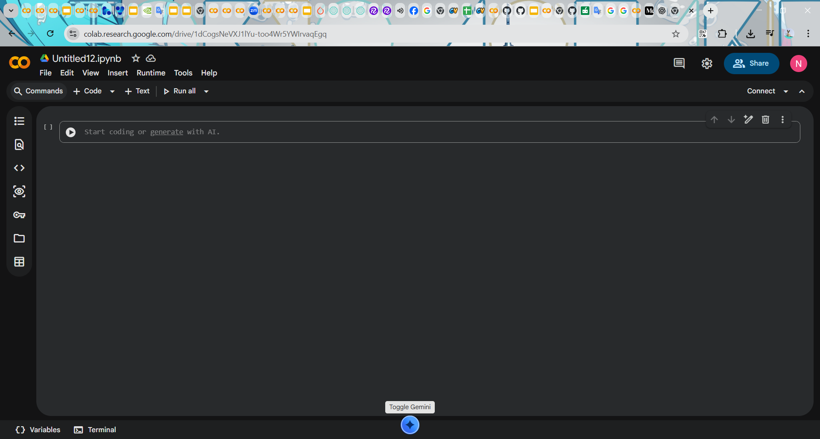
Material
With Google Colab, you don’t need to install any software. All you need is a Google account, and you can start using it right away. Simply visit: https://colab.research.google.com/ or select NEW NOTEBOOK to start a new file.
4

Slide 5
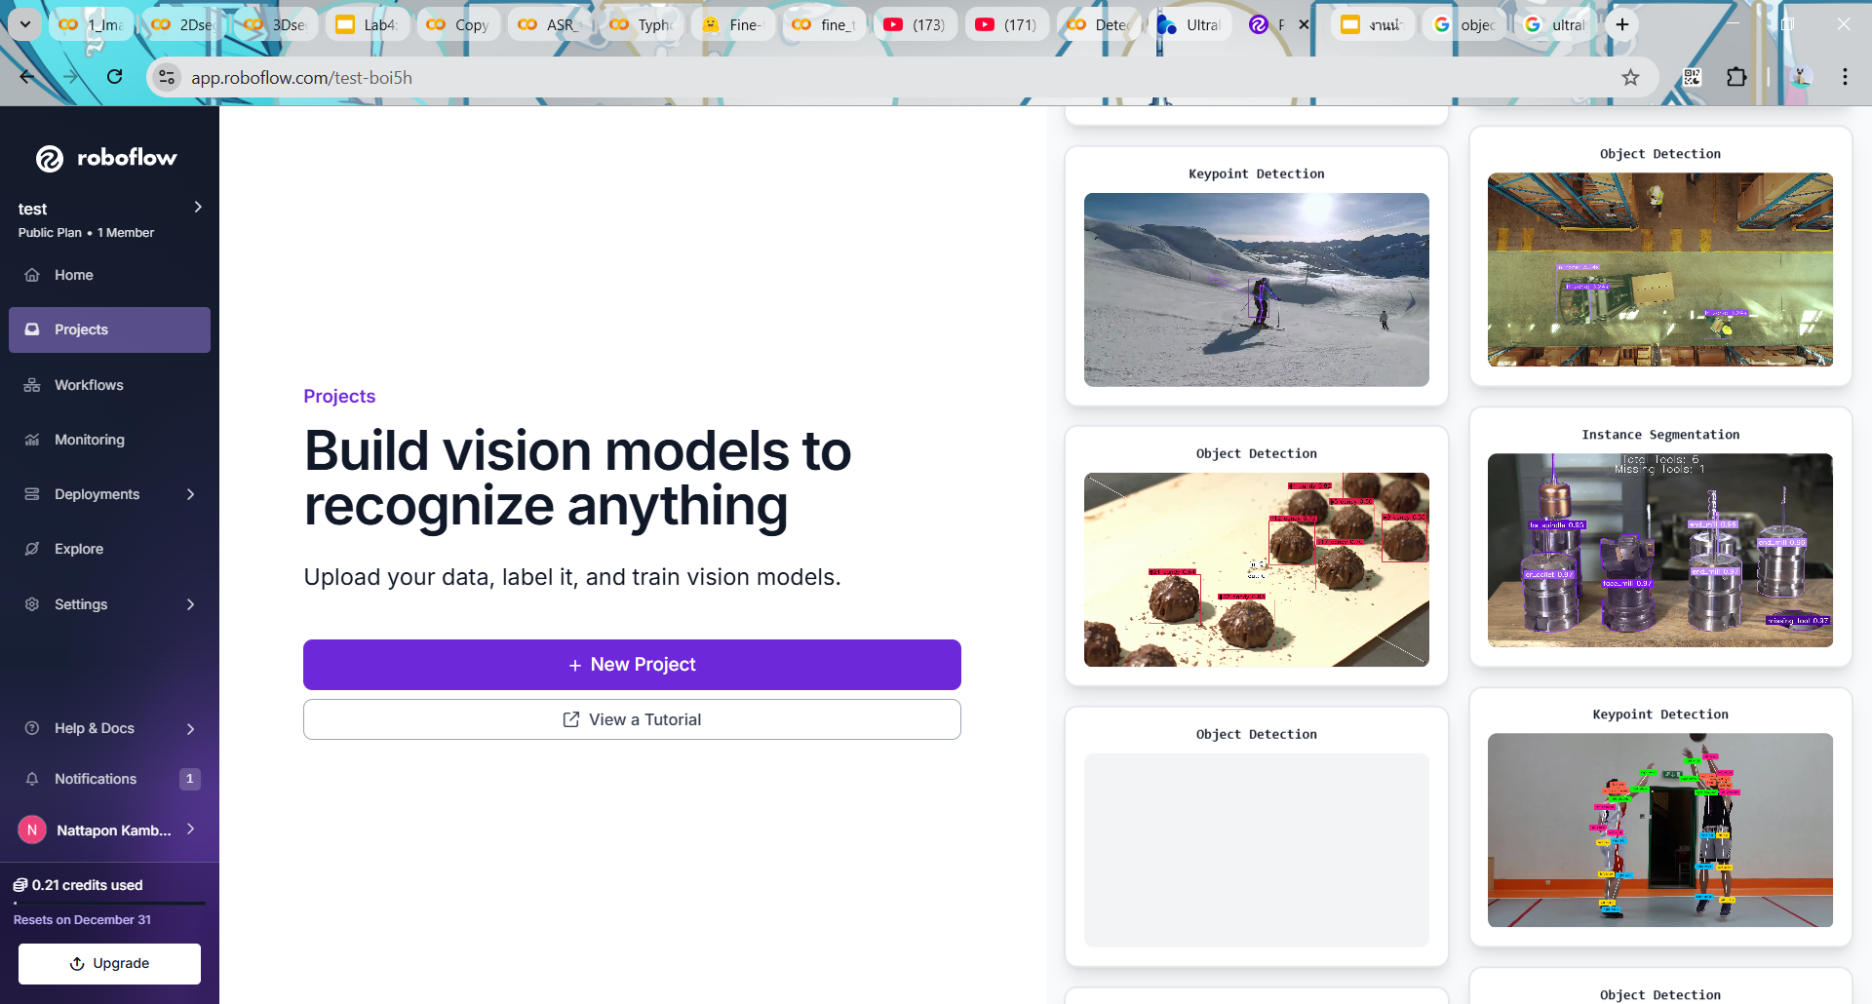
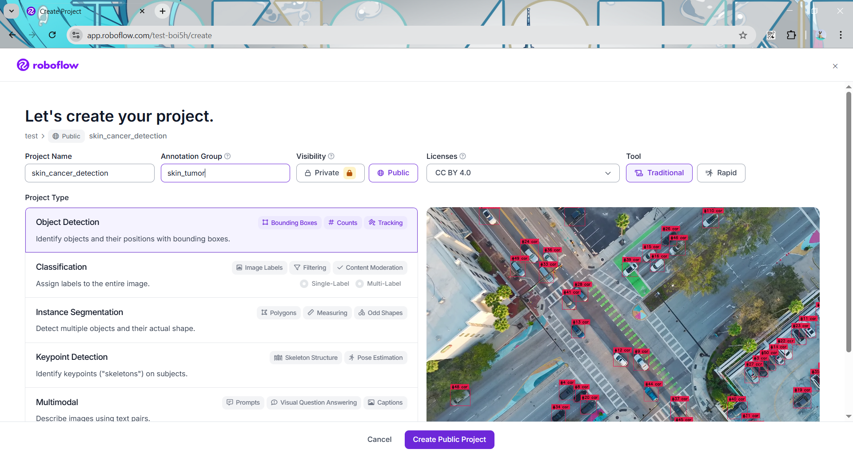
Roboflow
Roboflow is a web-based platform that helps users easily prepare datasets. It can be accessed through a web browser at https://roboflow.com/ by signing in with a Google or GitHub account.
Users can upload images, annotate data, apply preprocessing and data augmentation, and export datasets in formats ready for training models such as YOLO.
5

Slide 6
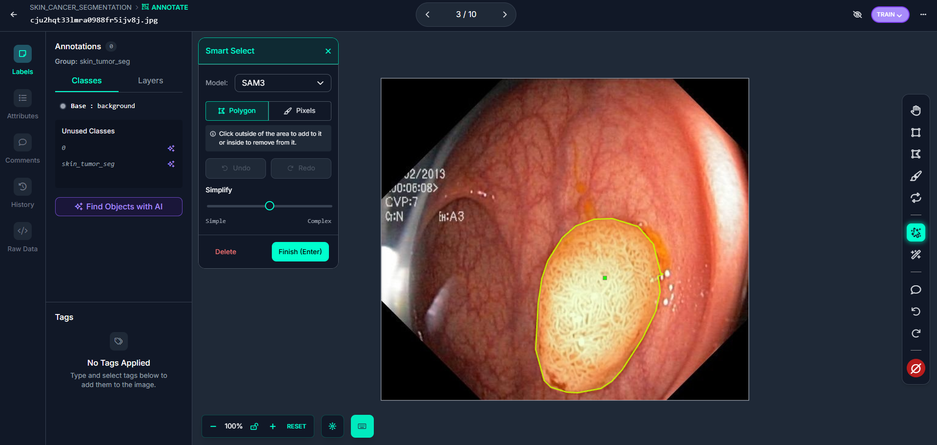
Roboflow (AI-Assisted Labeling)
Roboflow has implemented the SAM-3 model that allows users to build a computer vision detection model in just a few minutes. This tool is designed to quickly get projects and ideas up and running by allowing users to prompt what objects they want to detect.
6

Slide 7
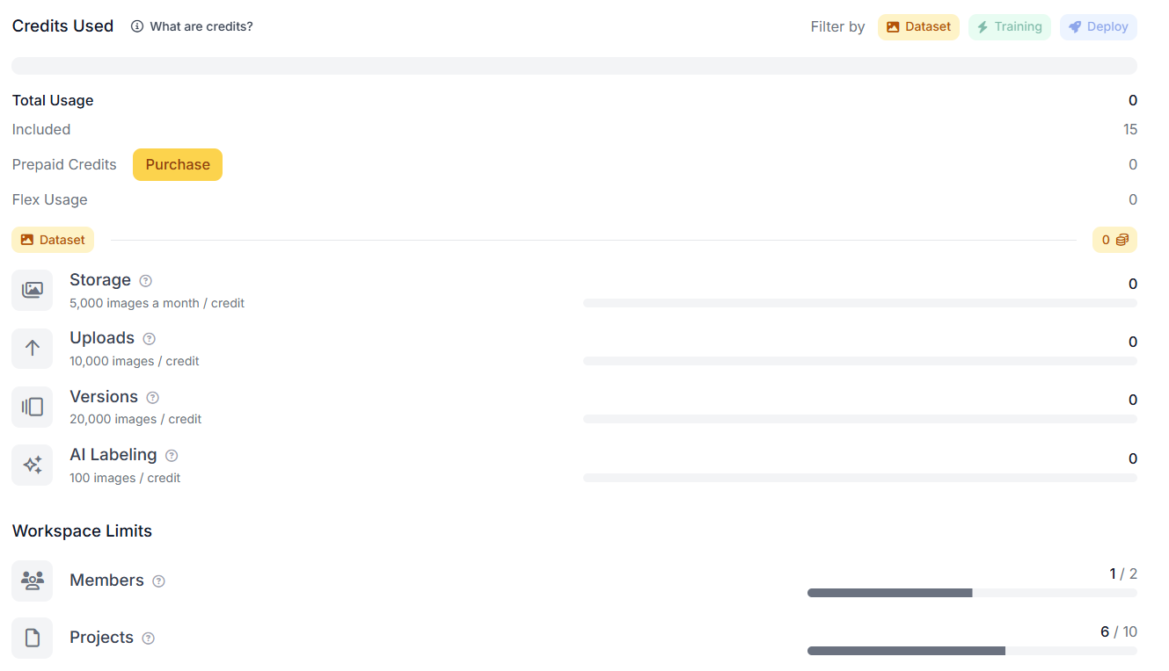
Roboflow (limitation)
In this lab, we use the Roboflow free plan, which comes with the following limitations:
7

Slide 8
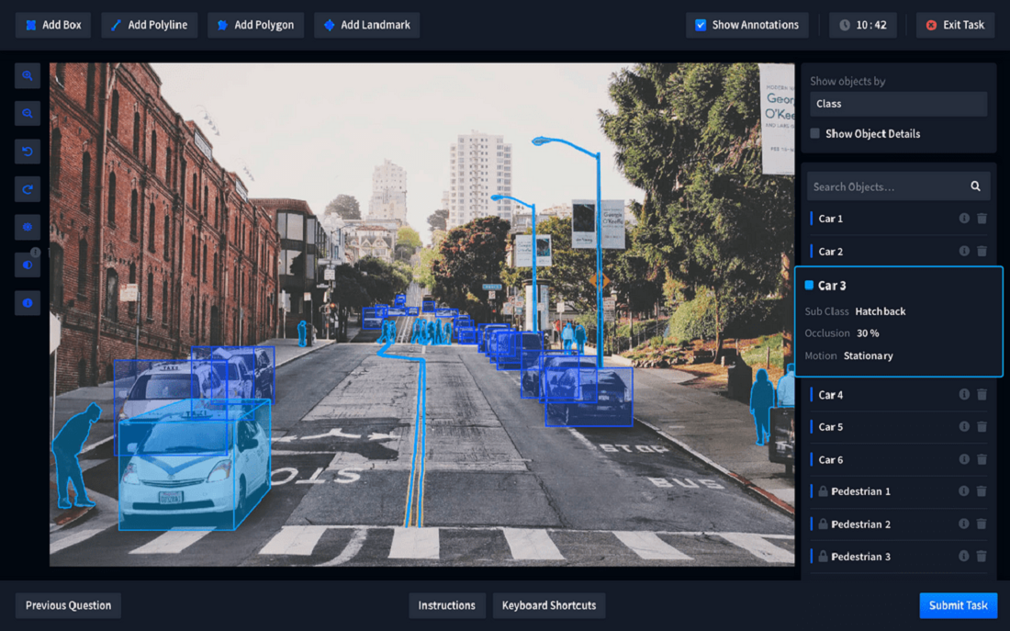
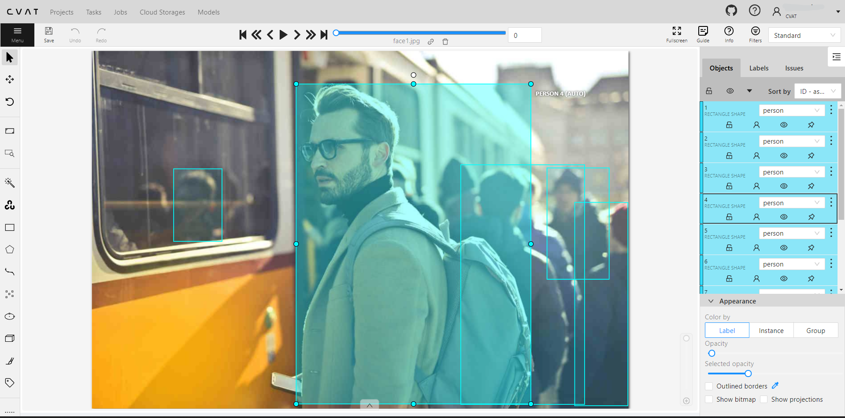
Other Data Labeling Tools
Besides Roboflow, there are other tools that can perform labeling, such as LabelMe and CVAT.
LabelMe
CVAT
8

Slide 9
Other Data Labeling Tools (cont.)
Tool | Developer | Main Use | Strengths | Limitations
CVAT | Intel | Detection, Segmentation, Tracking | • Powerful for large datasets • Supports image & video • Team collaboration | • Setup is complex • UI less beginner-friendly
Roboflow | Roboflow Inc. | Detection & Segmentation | • AI-assisted labeling • Dataset management & augmentation • Easy model export | • The free plan has limitations • Cloud-based
LabelMe | MIT CSAIL | Image Segmentation | • Simple and lightweight • Easy to use for beginners • Good for academic use | • Manual labeling only • Limited features for large datasets
9

Slide 10
Lab 6.1: Object detection dataset (Polyp Detection)
In this lab, we will repeat the experiment from Lab 4.1 (YOLOv8n), but the dataset will be created using Roboflow instead.
Load image from GitHub.
Create an object detection dataset in Roboflow
Train YOLO model in the Ultralytics Hub.
evaluate YOLO in Lab_6_1_ultralyricshub
Roboflow
Ultralytics Hub
Colab
Create dataset
Upload dataset
Load dataset
Tune hyperparameter
Load model
Inference & evaluate
Train model
Download model
10

Slide 11
Dataset: kvasir dataset (2017)
Kvasir dataset consists of 4,000 annotated images, including 8 classes showing anatomical landmarks, pathological findings, or endoscopic procedures in the GI tract.
The dataset consist of the images with different resolutions, from 720x576 up to 1920x1072 pixels in JPG format and documents in JSON format
The dataset was released in 2017 by the Simula Research Laboratory, Norway.
To keep the experiment simple and easy to follow, we selected only 100 images. These images are used to create target annotations for detection (Lab6.1) and segmentation (Lab6.2) in Roboflow.
11

Slide 12
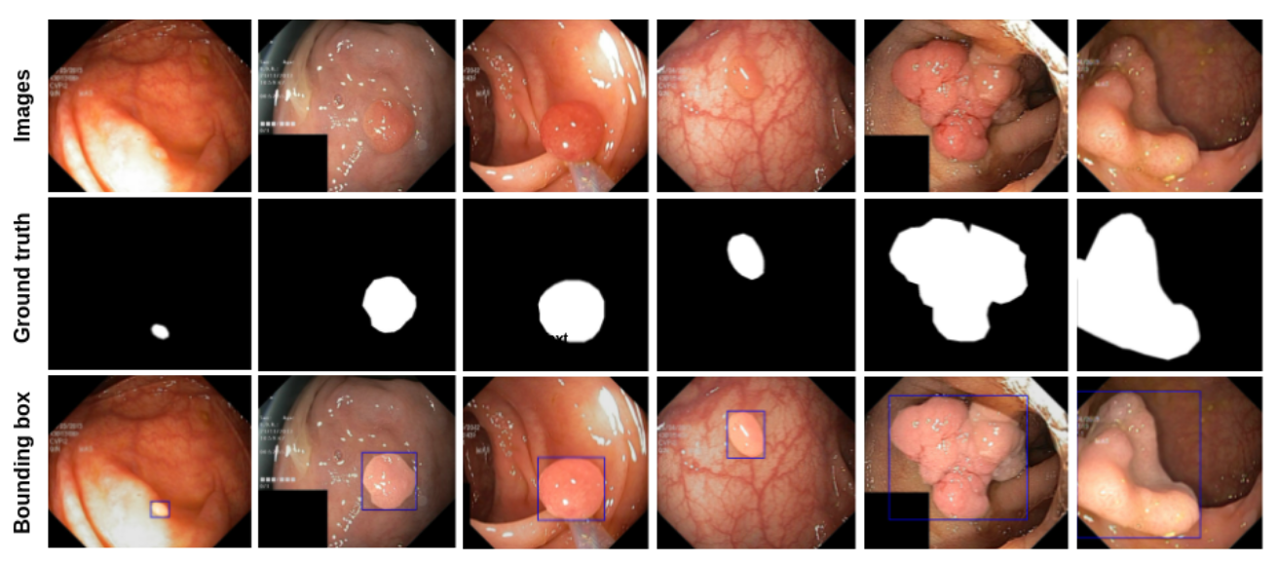
Dataset: kvasir dataset (2017)
The figure shows the example images, bounding box, and mask from Kvasir-SEG. The white mask shows the area covered by the polyp region, and the background regions contain non-polyp tissue pixels.
12

Slide 13
Lab 6.1: Object detection dataset
Sign in Roboflow
13

Slide 14
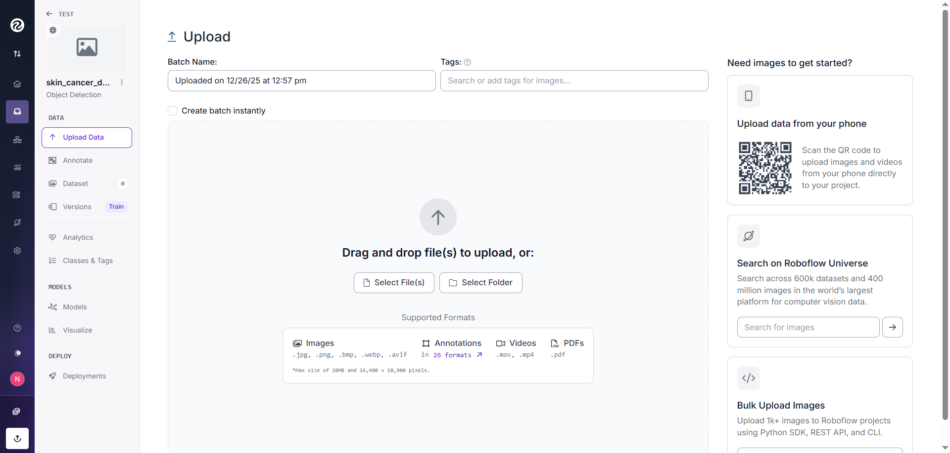
Lab 6.1: Object detection dataset
2) Create new project (Object Detection)
14

Slide 15
Lab 6.1: Object detection dataset
3) Download the dataset from GitHub, then upload it to Roboflow.
15

Slide 16
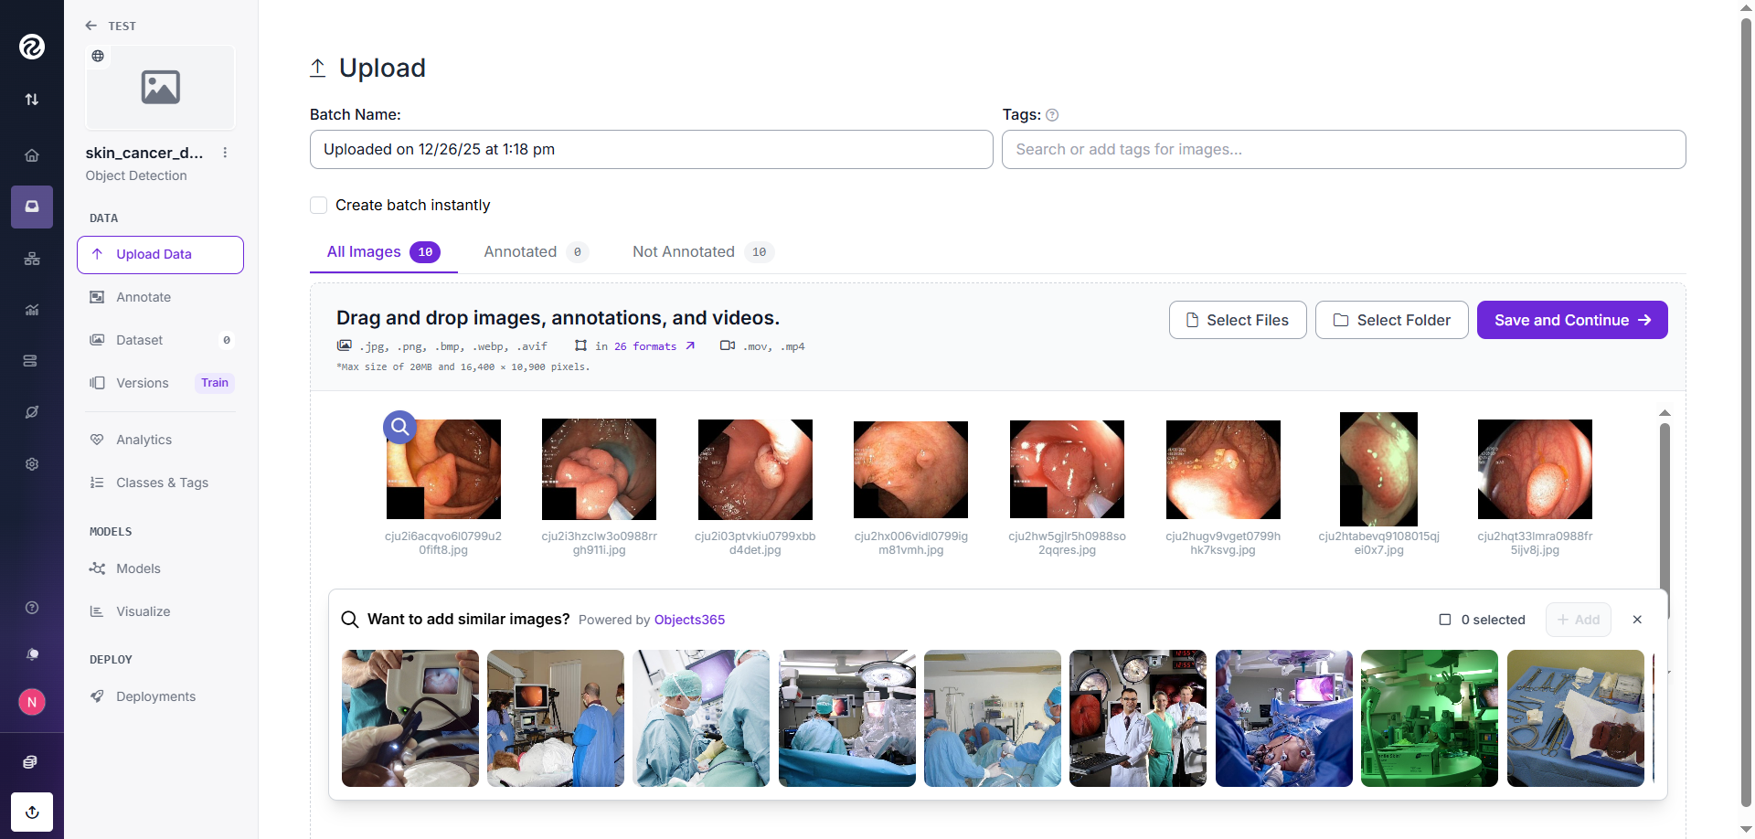
Lab 6.1: Object detection dataset
3) Download the dataset from GitHub, then upload it to Roboflow.
16

Slide 17
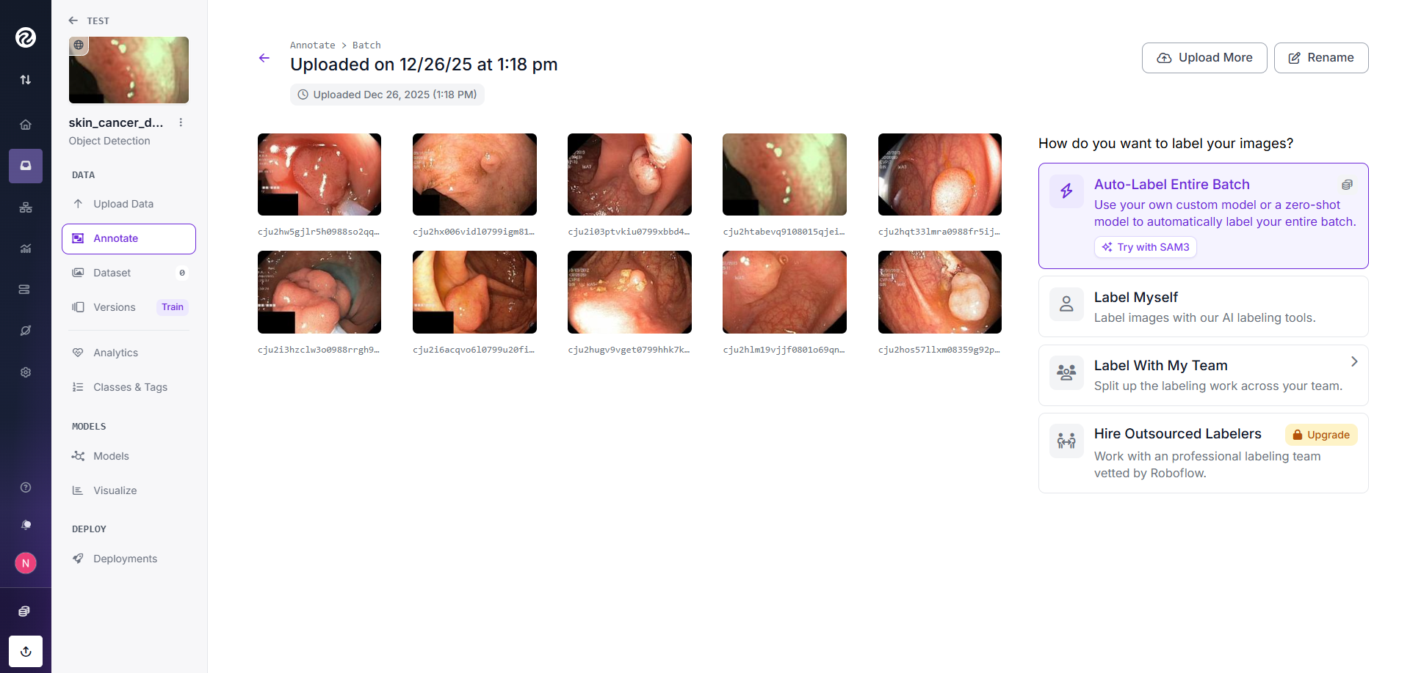
Lab 6.1: Object detection dataset
4) Check “Label Myself”
17

Slide 18
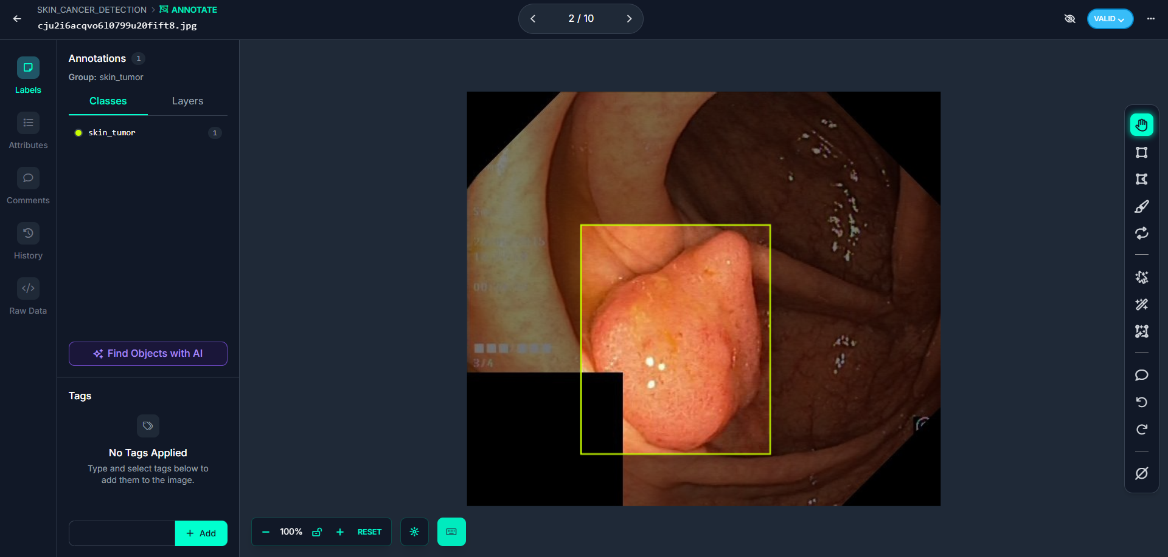
Lab 6.1: Object detection dataset
5) Label polyp
18

Slide 19
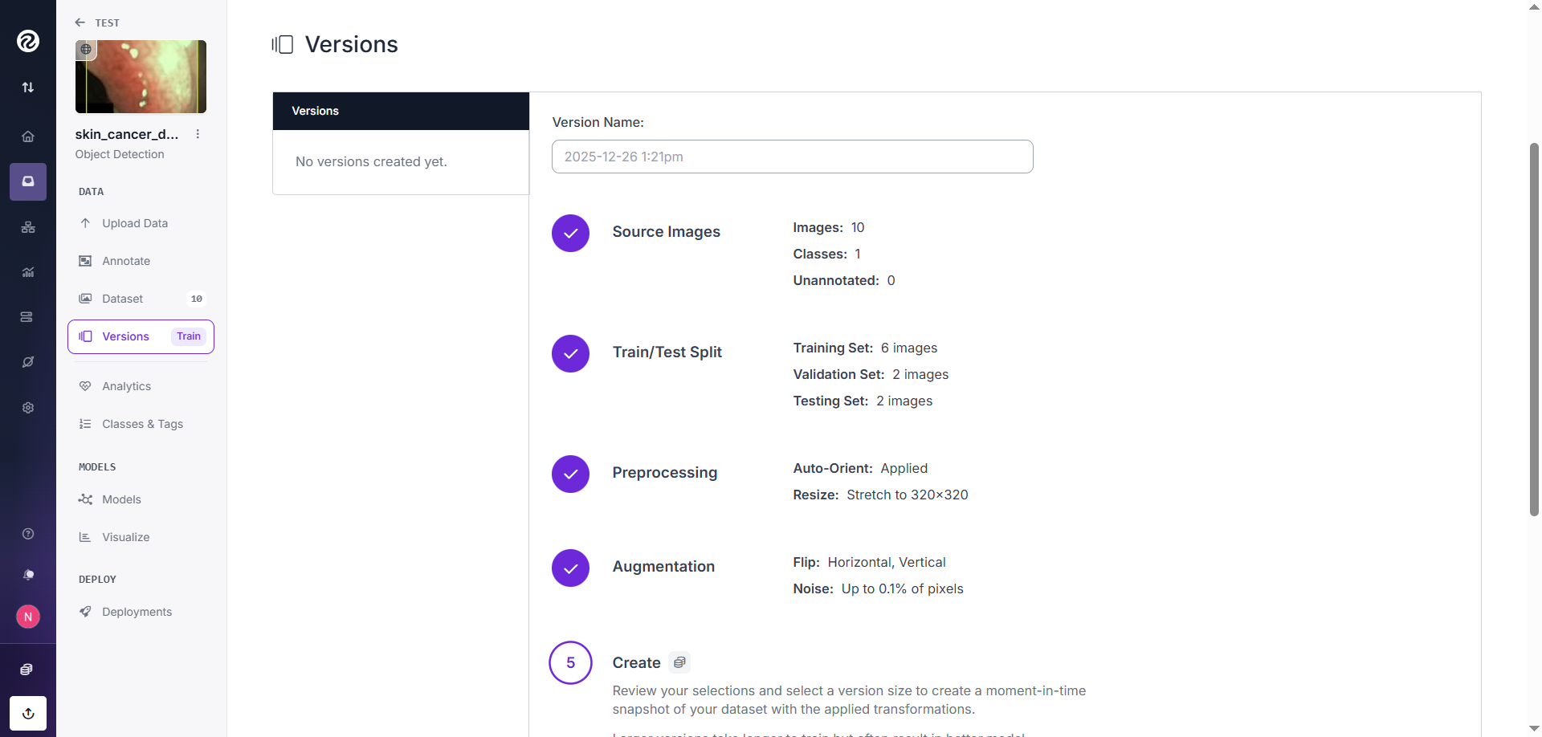
Lab6.1: Object detection dataset
6) Split Train:60%, Validation:20%, Test:20%
19

Slide 20
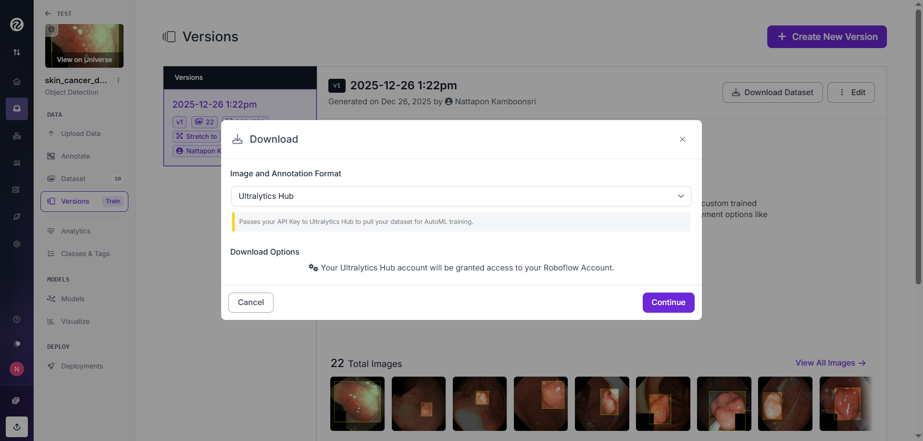
Lab 6.1: Object detection dataset
7) Download the dataset in two formats: (1) Ultralytics HUB format for training the model and (2) YOLOv8 format for evaluation using a Google Colab notebook.
20

Slide 21
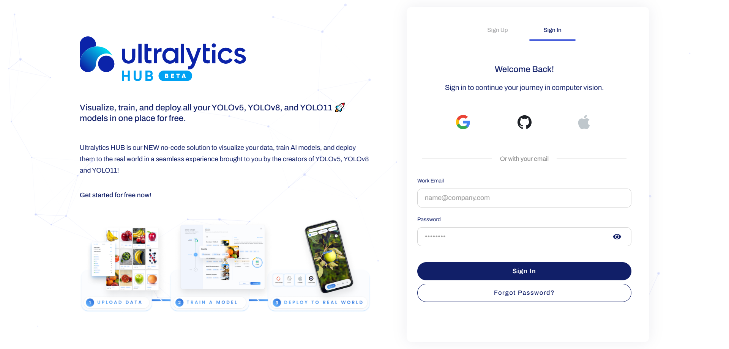
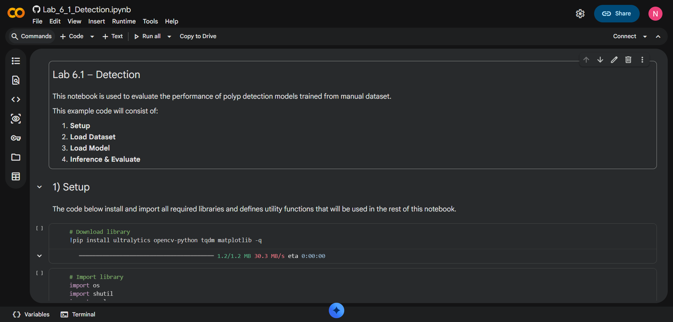
Lab 6.1: Object detection dataset
8) Train YOLOv8n in Ultralytics Hub
9) Load model to run in Lab_6_1_Detection (in Colab).
21

Slide 22
Lab 6.2: Segmentation dataset
(Polyp Segmentation)
Roboflow
Colab
Create dataset
Load dataset
In this lab, we will repeat the experiment from Lab 5.1 (2DUNet), but the dataset will be created using Roboflow instead.
Load image from GitHub
Create segmentation dataset in Roboflow
Download the dataset in segment formats
Upload the dataset to Lab_6_2_Segmentation, then train and evaluate the model.
Create Model
Train Model
Load best model
Inference & evaluate
22

Slide 23
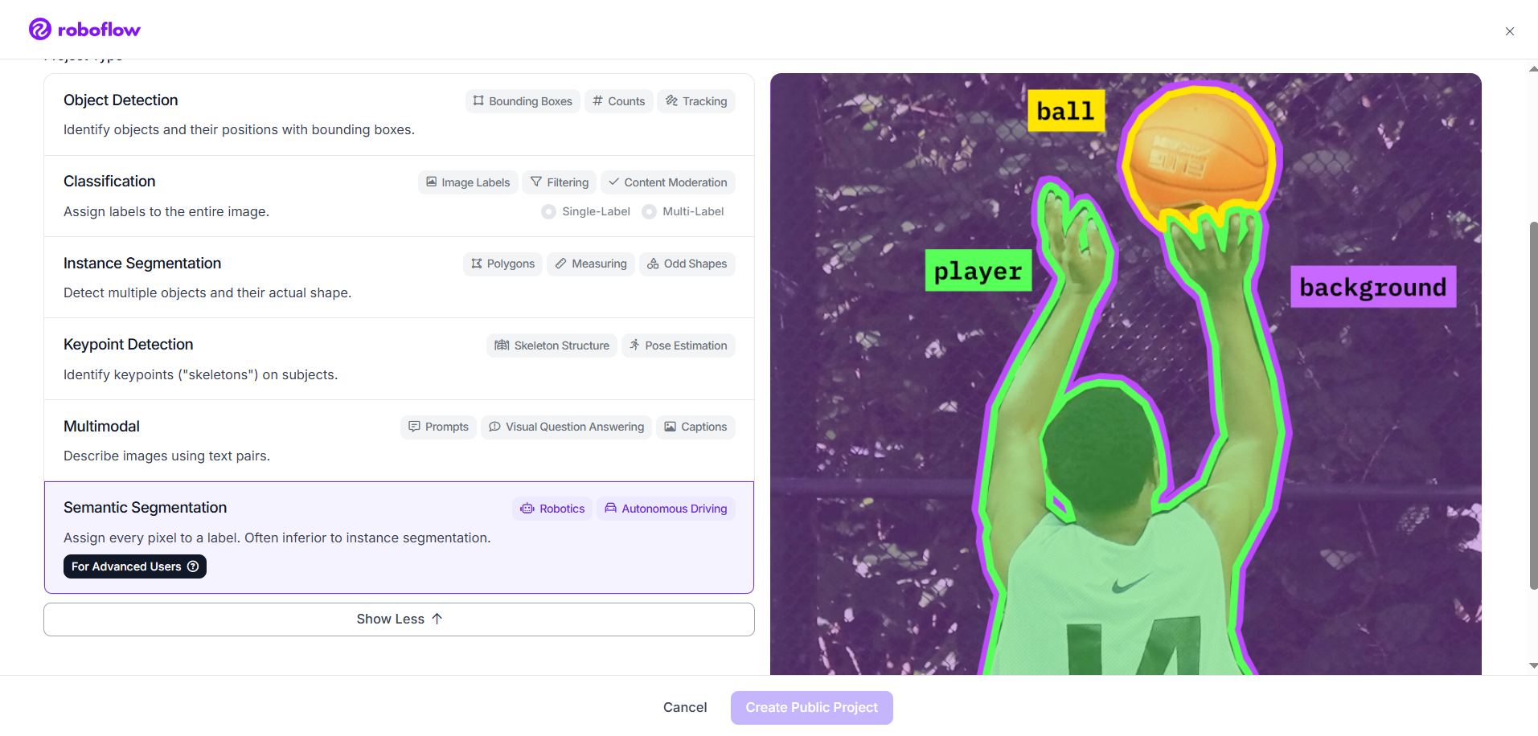
Lab 6.2: Segmentation dataset
In Lab 6.2, the labeling process is the same as in Lab 6.1. However, when creating the project, you must select “Semantic Segmentation.” Additionally, during the download step, the dataset must be saved in the “Semantic Segmentation Masks” format.
23

Slide 24
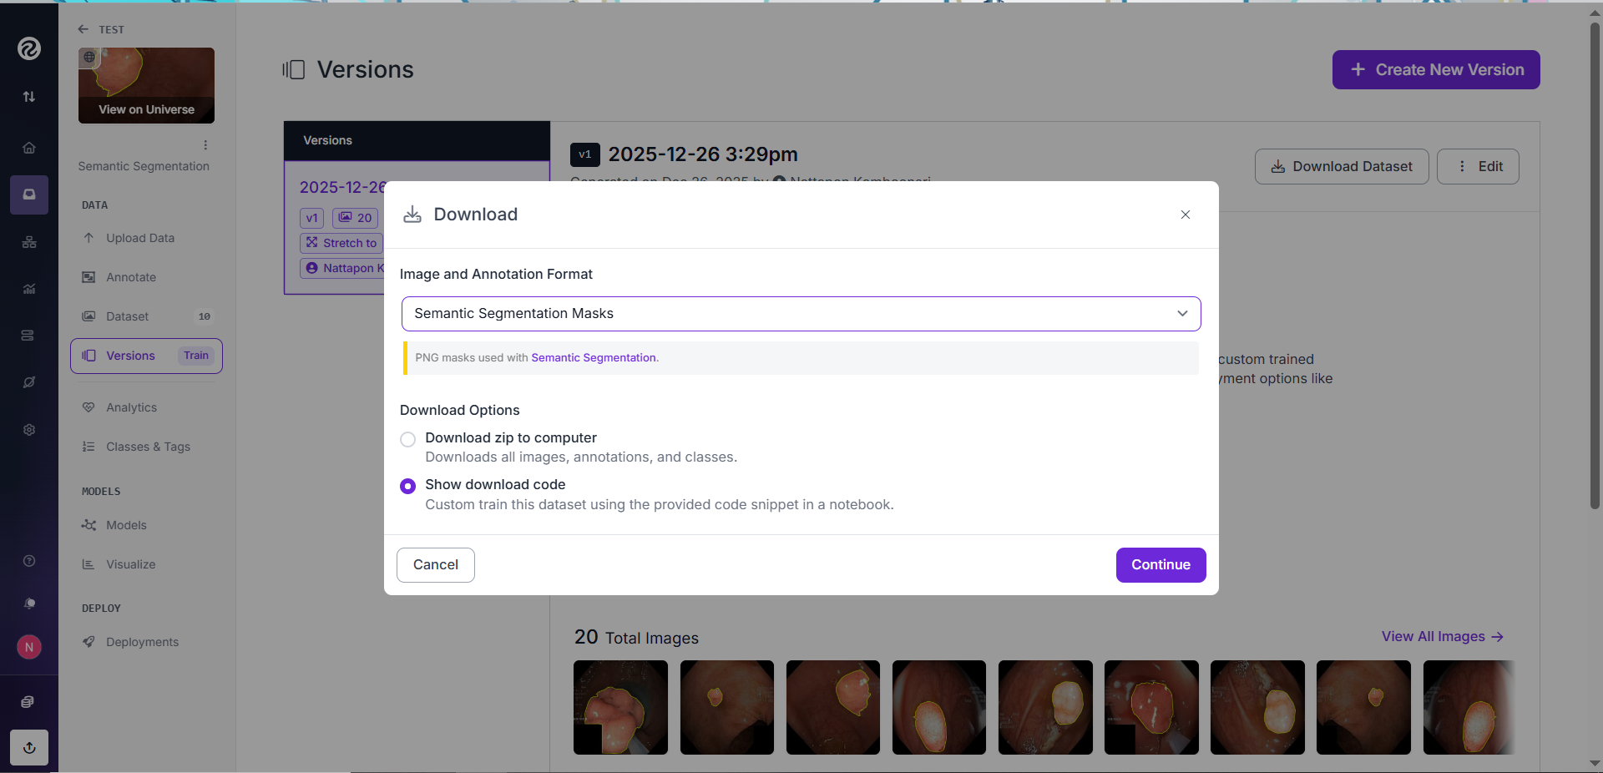
Lab 6.2: Segmentation dataset
In Lab 6.2, the labeling process is the same as in Lab 6.1. However, when creating the project, you must select “Semantic Segmentation.” Additionally, during the download step, the dataset must be saved in the “Semantic Segmentation Masks” format.
24

